Slide 1
Understanding New Jersey’s
Earned Sick Leave Law

Slide 2
Disclaimer
This presentation provides general information, not legal opinion. ​
The NJ Register and the NJ Administrative Code remain the official sources for regulatory information published by the NJDOL.

Slide 3
PowerPoint Presentation
Introduction
What is the law?
Who is covered?
What is the Notice of Employee Rights?
How does sick leave accrue?
When can I use earned sick leave?
How am I paid for my sick days?
What are some of the rules for employers?
Conclusion

Slide 4
Introduction
Applies to nearly ALL NJ Time to care for oneself and family
Employers must ensure existing policies are in compliance
Earned Sick Leave = Paid Sick Leave = Paid Sick Time = Paid Sick Day

Slide 5
Introduction
NJ Department of Labor and Workforce Development oversees implementation and enforcement
Required Notice of Employee Rights in 11 languages, one-page overviews, FAQs, and other helpful resources at mysickdays.nj.gov

Slide 6
What is the Law?
Employers must provide employees with up to 40 hours of paid sick time per year to care for themselves and family.
Employers may provide 40 hours up front or employees accrue 1 hour for every 30 hours worked.

Slide 7
Who is Covered?
Applies to nearly ALL employees, full-time, part-time and temporary
Regardless how you are paid- cash, piece rate or salary

Slide 8
Who is Covered?
Per diem
Seasonal
Nonprofit
Domestic workers
Homemaker-home health aide
Supervisors and managers
Regardless of citizenship status
Employees who work in NJ but employer is out of state

Slide 9
Who is Covered?
ALL employers, regardless of number of employees
Nonprofits
Faith-based organizations
Restaurants
Farms
Child care centers
Nearly all employers

Slide 10
Who is Not Covered?
The following people will not receive sick leave under this law:
Union construction workers under a collective bargaining agreement
Most per diem healthcare workers
Public employees who are provided sick leave with full pay pursuant to any state law, rule or regulation
Independent contractors (1099)

Slide 11
Collective Bargaining Agreement
For employees with an existing collective bargaining agreement (CBA) in effect on October 29, 2018, no provision of the law shall apply until the expiration of the CBA
Non-bargaining unit employees are still covered

Slide 12
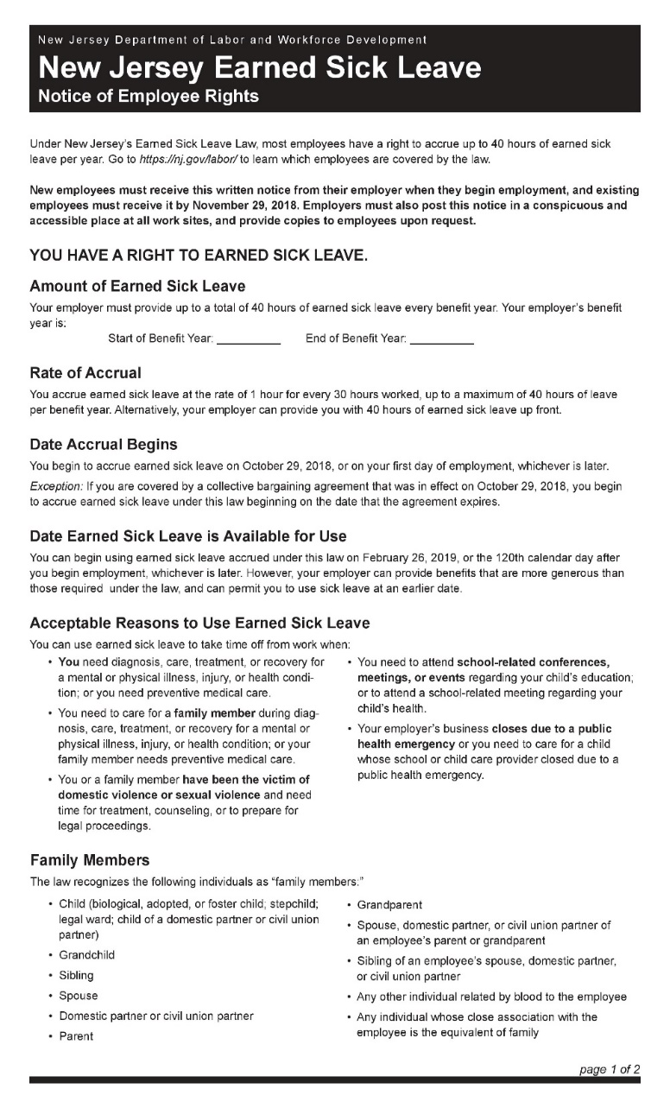
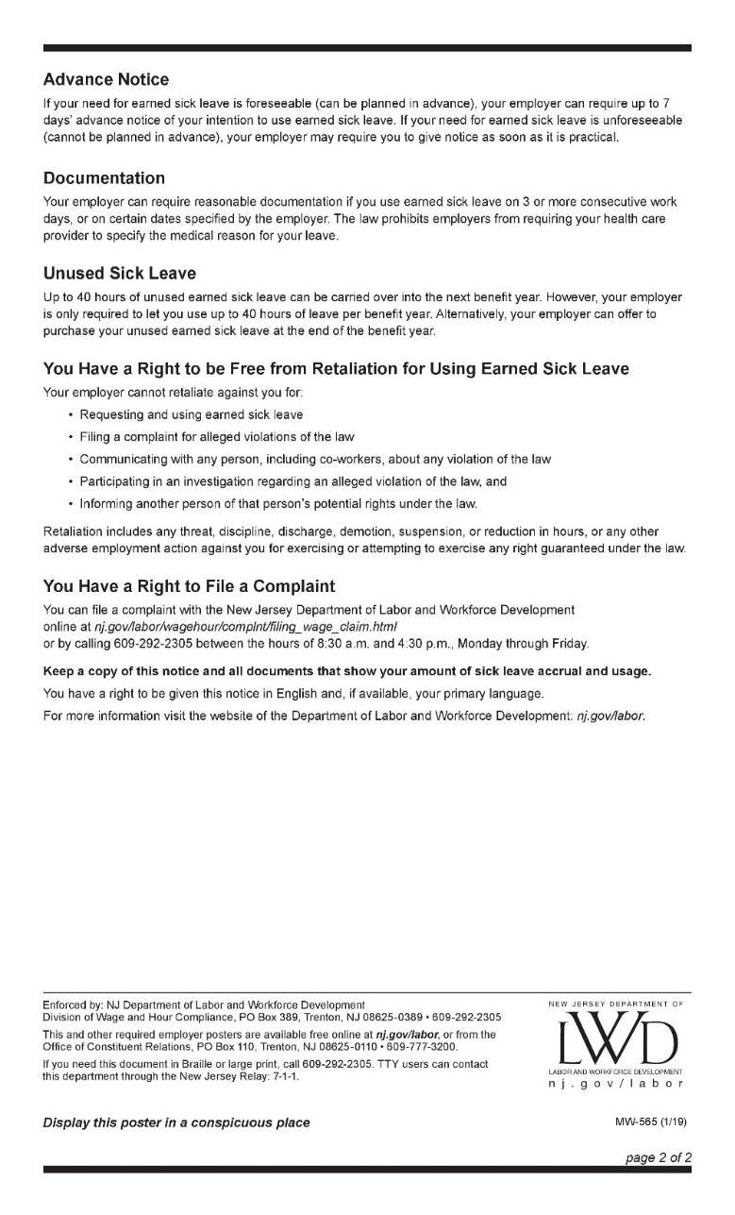
A Notice of Employee Rights is required to be posted in the workplace.
Notice of Employee Rights

Slide 13
How Does Sick Leave Accrue?
1 hour is accrued for every 30 hours worked -or- employer has the option to provide a lump sum/advance
Employer can limit usage to 40 hours per benefit year.

Slide 14
When Can I Use Earned Sick Time?
To care for yourself and family
Physical and mental health or injury, or wellness care
To get the COVID-19 vaccine and/or recover from side effects
Domestic or sexual violence
School meetings for your child
Public health emergencies that closed work, or the school or place of care of child

Slide 15
What is the Definition of “Family”?
Child (biological, adopted, or foster child; stepchild; legal ward; child of a domestic partner or civil union partner)
Grandchild
Sibling
Spouse
Domestic partner or civil union partner
Parent
Grandparent
Spouse, domestic partner, or civil union partner of an employee’s parent or grandparent
Sibling of an employee’s spouse, domestic partner, or civil union partner
Any individual related by blood to the employee
Any individual whose close association is the equivalent of family

Slide 16
Planned Sick Leave
When employee has planned to use sick leave (for example: doctor’s appointment for wellness care)
Employer may require 7 days’ advance notice
Notes:
There are two kinds of sick leave, scheduled and unexpected
An employer may require a maximum of 7 days’ advance notice for foreseeable use of earned sick leave

Slide 17
Unplanned Sick Leave
Employee is unable to reasonably anticipate their need for leave (for example: a child wakes up sick)
Employer may require that employee notifies the employer as soon as possible

Slide 18
How Am I Paid for My Sick Days?
Same rate employee normally earns (not including overtime)
Different calculations exist for the following types of employees:
Tipped Workers
Multiple Rates of Pay
Piecework
Commission
Your employer is required to pay you in the same or next pay period, and the pay must come with your regular pay check or another method that can be deposited or cashed easily.

Slide 19
Rules for Employers
If an employee has a need for earned sick leave, an employer may require documentation only when:
Employee has used 3 or more consecutive days
It’s a high-volume period for the business, or there is a special event
Employer cannot require documentation for 1 or 2 days of absence

Slide 20
Rules for Employers (cont.)
An employer cannot discipline an employee who uses earned sick leave for a permitted reason
An employer is not allowed to require an employee to find coverage when using earned sick leave, or make up the hours
Retaliation is against the law

Slide 21
What Can Retaliation Look Like?
Discipline, discharge, demotion, suspension, a loss or reduction of pay, or any other adverse action.
Examples include:
Refusing to permit a worker to take an overtime shift
Changing an employee’s schedule
Changing an employee’s type of work
Implementing a timekeeping system

Slide 22
Rebuttable Presumption
The law also includes a rebuttable presumption provision. Rebuttable presumption is a legal principle that means something is taken to be true unless someone proves otherwise.
If you
File a complaint
Cooperate with an investigation
Tell others about an alleged violation, or
Inform others of their rights
and then within 90 days, your employer takes adverse action against you, the law requires NJDOL to presume that there has been unlawful retaliation. Then, your employer would have to prove otherwise.
In legal terms, an “adverse” action generally means that it would dissuade a reasonable worker from exercising their rights.

Slide 23
What Happens to Unused Sick Leave?
Unused leave time at the end of a benefit year is either carried over or bought back by the employer
Up to 40 hours can be carried over per benefit year
Employees are permitted to have more than 40 hours of ESL in their leave bank
However, an employer is permitted to limit them to 40 hours usage or carry over per year

Slide 24
Are Your Rights Being Violated?
Visit mysickdays.nj.gov
Notice of Employee Rights in 11 languages
One-page overviews
FAQs
Helpful resources
File or download complaint form online

Slide 25
Filing a Wage and Hour Complaint
File a complaint for free:
Online: myworkrights.nj.gov
Mail or Fax:
New Jersey Department of Labor and Workforce Development Division of Wage and Hour Compliance, P.O. Box 389 Trenton, NJ 08625-0389 Fax: (609) 695-1174
Print a paper form at: nj.gov/labor/file

Slide 26
Tips on Filing a Complaint
A trusted person may file on your behalf or help you file. Groups of employees must file separate complaints.
Supply current address, contact information, description of claim, and any supporting documentation (e.g. time records, checks, pay stubs).
Answer accurately and submit copies, not originals, of all relevant documents.
You may be asked to provide additional details (i.e. employer information, hours worked).
Farm workers, email farms@dol.nj.gov to tell us you’ve filed or to get help.
For questions for NJDOL, call (609) 292-2305 or email wage.hour@dol.nj.gov
NJDOL will make every effort to provide assistance in your language

Slide 27
Confidentiality and Filing Anonymously
If you filed a complaint or are a witness that provided a statement, we will protect your name and identifying information to the maximum extent allowable under the law.
To file anonymously, file by mail or fax. Write “ANONYMOUS” in the name section of the complaint form and leave address blank. You won’t receive information about your complaint or be able to check its status.

Slide 28
Protection from Retaliation
Employers may not retaliate against you for filing a complaint, it’s against the law. Employers that break the law can face fines and penalties. Learn more at myworkrights.nj.gov.
NJDOL employees do not ask questions about immigration or citizenship and serve all workers regardless of their status. NJDOL will not share any information from an investigation with any federal immigration agency, unless legally required to do so.

Slide 29
NJ Work Rights & Benefits Overview
myworkrights.nj.gov
Info for tipped workers, farm workers, domestic workers
Misclassification
Safe and Healthy Workplaces
NJ Paid Family and Medical Leave: myleavebenefits.nj.gov
Job-Related Injuries: nj.gov/labor/workerscompensation
NJ Law prohibits discrimination at work
njcivilrights.gov

Slide 30
You have the Right to be Paid
You’re due the full amount of wages owed, for all hours worked, and no less than the applicable state minimum wage.
Overtime: Most workers are owed 1.5 times regular hourly rate of pay for hours worked over 40 hours/week
Public Construction (i.e., schools, buildings, roads): Contractors must register with the State and pay prevailing wage
Misclassified as independent contractor (1099) or paid cash off the books: you’re not at fault, but you could be deprived of work rights and other benefits. Misclassified employees may be entitled to financial award.
Learn more at myworkrights.nj.gov

Slide 31
More NJ Work Rights & Benefits
NJ Paid Family and Medical Leave
Cash benefits to care for yourself and loved ones (requires valid SSN)
Job may be protected under federal/state law
myleavebenefits.nj.gov
Job-Related Injuries
You may be eligible for Workers’ Compensation
nj.gov/labor/workerscompensation

Slide 32
More NJ Work Rights & Benefits
Safe and Healthy Workplace
Employers must follow state and federal OSHA standards
nj.gov/labor/safetyandhealth
NJ Law Prohibits Discrimination at Work
njcivilrights.gov

Slide 33
LET’S DISCUSS
What questions do you have?

